Slide 1
Test Automation Using Selenium

Slide 2
Test Automation
Test automation is the use of software
To set test preconditions.
To control the execution of tests.
To compare the actual outcomes to predicted outcomes.
To report the Execution Status.
Commonly, test automation involves automating a manual process already in place that uses a formalized testing process.

Slide 3
Why and When To Automate?
Frequent regression testing
Repeated test case Execution is required
User Acceptance Tests
Faster Feedback to the developers
Reduce the Human Effort
Test same application on multiple environments

Slide 4
Selenium
Selenium is a robust set of tools that supports rapid development of test automation for web-based applications.
Selenium provides a rich set of testing functions specifically geared to the needs of testing of a web application.
Selenium operations are highly flexible, allowing many options for locating UI elements and comparing expected test results against actual application behavior.

Slide 5
Selenium Features
Supports Cross Browser Testing. The Selenium tests can be run on multiple browsers.
Allows scripting in several languages like Java, C#, PHP and Python.
Assertion statements provide an efficient way of comparing expected and actual results.
Inbuilt reporting mechanism.

Slide 6
Selenium IDE
Selenium IDE is an integrated development environment for Selenium tests.
It is implemented as a Firefox extension, and allows you to record, edit, and replay the test in firefox
Selenium IDE allows you to save tests as HTML, Java, Ruby scripts, or any other format
It allows you to automatically add assertions to all the pages.
Allows you to add selenese commands as and when required

Slide 7
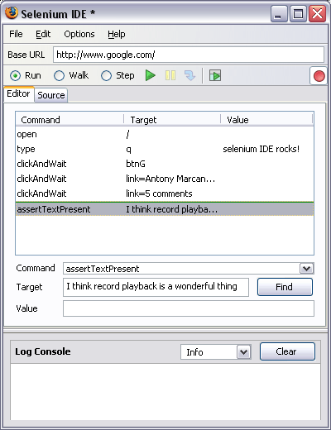
Selenium IDE - UI
Start and Stop
Recording
Replay
Toolbar
Selenium
Script
Editor
Accessor
Area
Selenium Log

Slide 8
Recoding a Selenium Test Case
Open Firefox that has the IDE installed
Open the base URL of the application to record.
Keep the application in a common base state.
Go To Tools → Selenium IDE and the IDE will be opened
Now perform the operations on the application as you are testing the application.
Once you are done with the recording click on the stop recording button and save the test case through the file menu. By default it will be saved as a selenium script (HTML format)

Slide 9
Running Selenium Script
Make sure the application is in the common base state.
Click on the run button. Here you can also control the speed of the execution using the toolbar
Once the test is run you can view the test log in the bottom of the IDE window

Slide 10
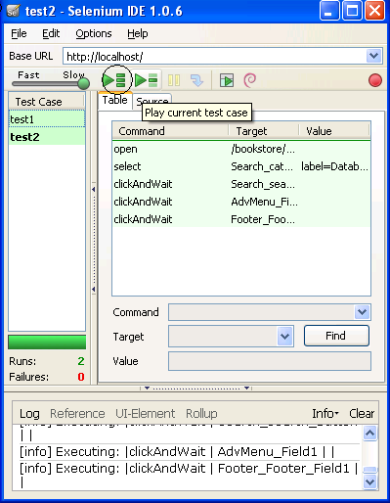
Creating a Test Suite
In the Selenium IDE you can create any number of test cases and save them as test suite.
To Run the test Suite click on the “Play entire test suite” button as shown below.
Test Suite with
Test1 & test2

Slide 11
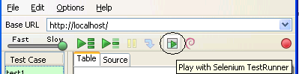
Playing The test Suite with Test Runner
Test Runner allows you to run the test case in a browser loaded with the Selenium-Core TestRunner.
Test runner is invoked by clicking the below Shown button in the IDE
On Clicking the Test Runner Button you will the window as seen in the next slide

Slide 12
Running Options
Start from the Middle
You can tell the IDE to begin running from a specific command in the middle of the test case. This also is used for debugging. To set a start point, select a command, right-click, and from the context menu select Set/Clear Start Point.
Run Any Single Command
Double-click any single command to run it by itself. This is useful when writing a single command. It lets you immediately test a command you are constructing, when you are not sure if it is correct. You can double-click it to see if it runs correctly. This is also available from the context menu.

Slide 13
Assertions
Assertions are same as Verifications. The only difference is, if the assertions fail the script will abort. But the script will continue run in case a verification point fails.
The steps for inserting the assertions is same as that of verification point.
While recording Right Click → Show all commands → select an assertion.

Slide 14
Assertion Statements
assertTextPresent
This will assert if the text is present in the page.
assertText
This will assert if a particular element is having the particular text.
assertTitle
This will assert if the page is having a proper title.
assertValue
This will assert if a Text box or check box has a particular value
assertElementPresent
This will assert if a particular UI Element is present in the page.

Slide 15
Store Commands
Store command are used to fetch the values from the application and store it in a variable. These variables can be used latter for validation purpose.
The Store command can be used to retrieve the page title, text from the page and other attributes from the application.

Slide 16
Limitations of Selenium IDE
Can run the test only on Firefox
No Programming login (like loops, conditional statements) can be applied
Selenium IDE can execute scripts created in Selenese only.
It is difficult to use Selenium IDE for checking complex test cases involving dynamic contents

Slide 17
Selenium RC
A solution to cross browser testing.
A server, written in Java and so available on all the platforms.
Acts as a proxy for web requests from them.
Client libraries for many popular languages.
Bundles Selenium Core and automatically loads into the browser

Slide 18
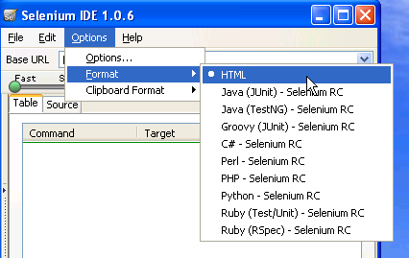
Selenium Test Automation Process
First Generate the Script using selenium IDE in the firefox IDE
Once the Scripts are recorded add assertions where ever required
Now format the Selenese test into the language of your choice. Please refer to the Image

Slide 19
Selenium Test Automation Process
Once the Selenese script is converted into your preferred language you can you can run them using Selenium Server.
For running the script you also need the client driver for that particular language.
To enhance the script we will require IDE like netbeans or Eclipse IDE
To Integrate the script and run them as a suite we will require build integration tools like Maven or Ant.

Slide 20
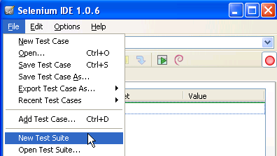
Running a Selenese Test on Different Browsers
Following are the steps to create a selenese test suite and run a test suite using selenium RC
Record a test case using selenium IDE and save it as “Test1.html” (say).
Record another test case using selenium IDE and save its as “Test3.html” (say).
In this way you can record any number of test case using selenium IDE and save them as <filename>.html
Then Create a New Test Suite using the File Menu. See the Image Below.

Slide 21
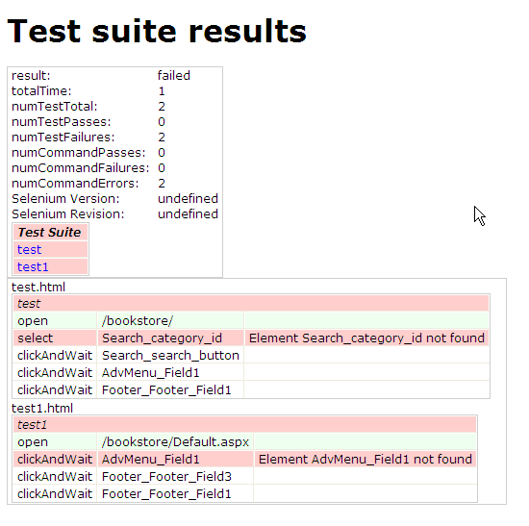
Selenium Suite
Command :
java -jar selenium-server.jar -multiwindow -htmlSuite "*iexplore" "https://localhost/bookstore/" "D:\testa.html" "C:\results.html“
Once the command is run the results will be stored in the results.html file as shown below.

Slide 22
Client Drivers
Enables communication with Selenium Remote Control Server.
Functionality of Selenium is exposed via these drivers.
Available in Ruby, Python, Java, C-Sharp …and so on.
Give access to the rich features and libraries of the language, including their unit testing framework.
Makes it possible to develop automated scripts in the same language as product.
Which one you should use?
Whatever make sense in your context. Most Popular is java and for the training we will use java

Slide 23
Process of Developing Selenium Java Scripts.
Following are the steps for generating the
test scripts in java
Record the Script in Selenium IDE and format them into Java
Create a Selenium Java project in Eclipse and load all the necessary jar files
Copy the formatted Java code into the Eclipse and run the test.

Slide 24
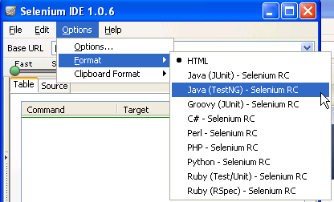
Formatting the recorded script into Java
Steps of formatting the code into java
Open the Browser and open the base URL of the application.
Open the Selenium IDE and start recoding the test steps.
Once the recording is done go to Menu → Options → Format → Java(TestNG) –Selenium RC
You can see the java code in the source tab of IDE. Save the test case with .java extension.

Slide 25
Setting Up an Eclipse Project for Selenium Automation
Eclipse is an open source community whose projects are focused on building an extensible development platform for building Java applications and frameworks. Eclipse is one of the best Java IDE and as a matter of face Eclipse is much more than a Java IDE.
We can configure a selenium project in eclipse and even run the scripts from eclipse.
Using eclipse its easy to enhance the recorded script. We can add power to the recorded script by parameterizing the test inputs and even validate the back values.
Eclipse also allows us to write reusable code for efficient test automation.

Slide 26
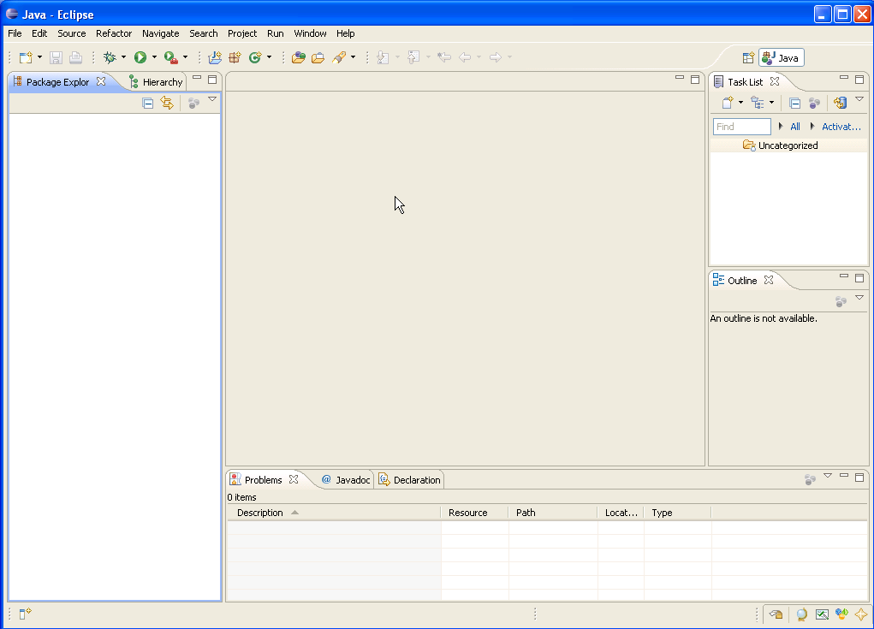
Eclipse IDE
Scrip View
Package
Explorer
console

Slide 27
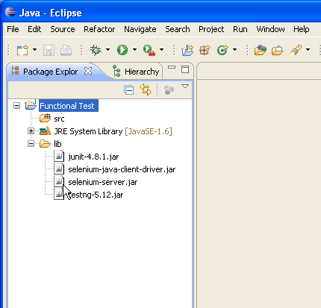
Selenium Libraries

Slide 28
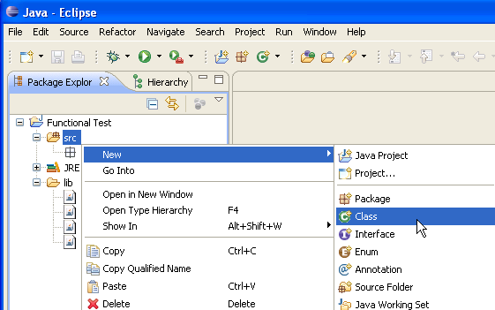
Creating a package and adding a class file
In the eclipse → Package Explorer → right click on the src (source) folder. In that select New → Package and give a name to the package. See the Picture1
Now right click on the created package and click on new → class and provide a class name. You will see a java script template as seen in the next slide

Slide 29
Creating the test script inside the class file
Copy the code that was formatted in the selenium IDE and paste it in the Eclipse IDE script template.
Make sure the class name that you created and the class name in the script are same
Make sure that you have add the methods setUp and tearDown

Slide 30
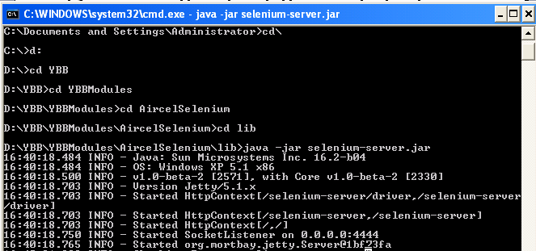
Running the test through Eclipse
Start the Selenium Server
For this open the command prompt and go to the folder where the selenium server is present.
Run the command “java -jar selenium-server.jar”
The Selenium server will start running and you can see the message in the command prompt.

Slide 31
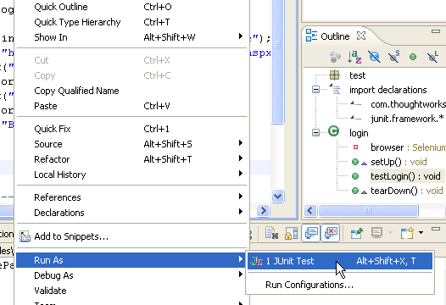
Running the test through Eclipse
Once the server is up go to the eclipse and right click on the script.
In that select Run As → JUnit Test. See the image below. After this you will get will see that the script has run successfully in the window that’s shown in the next slide.

Slide 32
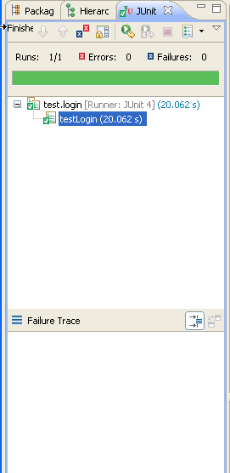
Selenium Results Strip in the Eclipse IDE
success
failure

Slide 33
Components of the Selenium test Script
setUp method
This method prepares the selenium server to run the test. This method basically hooks to the selenium server and opens up the base URL of the application
test*** method
The methods with the name test will actually run the tests on the application. There can be any number of test methods in the app
tearDown method
This method will run after the end of the test. This test will disconnect with the server and makes room for the next tests to run the tests.

Slide 34
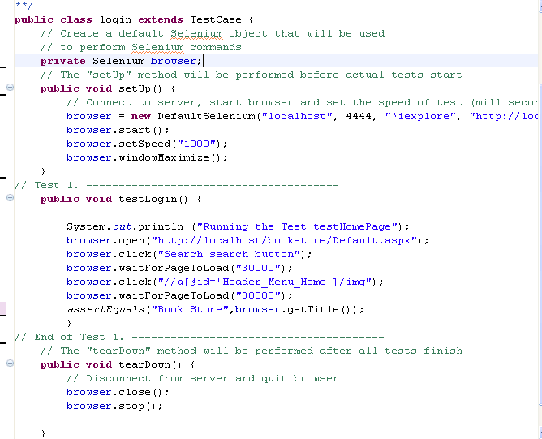
Script View

Slide 35



Use string functions

Slide 36
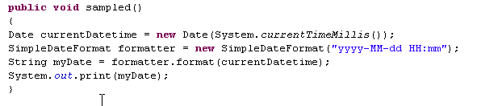
Date Functions
Required Packages
import java.util.Date;
import java.text.SimpleDateFormat;
Sample Code

Slide 37
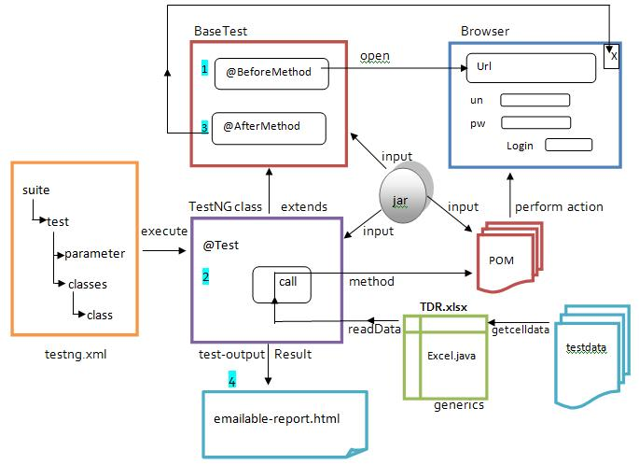
Selenium webdriver community

Slide 38
package newproject;
import org.openqa.selenium.WebDriver;
import org.openqa.selenium.firefox.FirefoxDriver;
public class PG1 {
public static void main(String[] args) { System.setProperty("webdriver.firefox.marionette","C:\\g eckodriver.exe");
WebDriver driver = new FirefoxDriver();
String baseUrl = “https://www.wikipedia.org/";
String expectedTitle = "Welcome: Mercury Tours";
String actualTitle = "";
driver.get(baseUrl);
actualTitle = driver.getTitle();
if (actualTitle.contentEquals(expectedTitle)){ System.out.println("Test Passed!");}
else { System.out.println("Test Failed");}
driver.close();}
}

Slide 39
The above code is simply to test that if the page url provided is having the same title as the expected title or not.
Benefits
-open source
-supports multiple languages like java, perl, ruby, c#, python.
-can be run in windows, mac, linux or UNIX

Slide 40
Automation tools are used to execute testcases.
Faster than manual approach.
Regression, Performance, Load testing is suitable.
Automated Tests have zero risks of missing out a pre-decided test.
Not cost effective for low volume regression
Can be done on different parallel operating platforms reducing time taken.
Testcases are manually tested by analysts.
Time consuming takes up human resource.
Exploratory, usability testing is suitable.
Manual testing may have risk of missing out a such test.
Not cost effective for high volume regression
Only time can be reduced by increasing manpower.

